Slide 1

INVENTORY & SUPPLIER MANAGEMENT SYSTEM

Slide 2
Abstract
Managing inventory manually leads to problems such as:
Inaccurate stock records
Difficulty in tracking suppliers
Poor management of purchase orders
Delay in payment tracking
A database-driven system is required to efficiently manage inventory and supplier information.

Slide 3
OBJECTIVES
The objectives of this project are:
To design a structured inventory database
To manage supplier and product details efficiently
To track stock availability
To maintain purchase order records
To store payment details securely

Slide 4
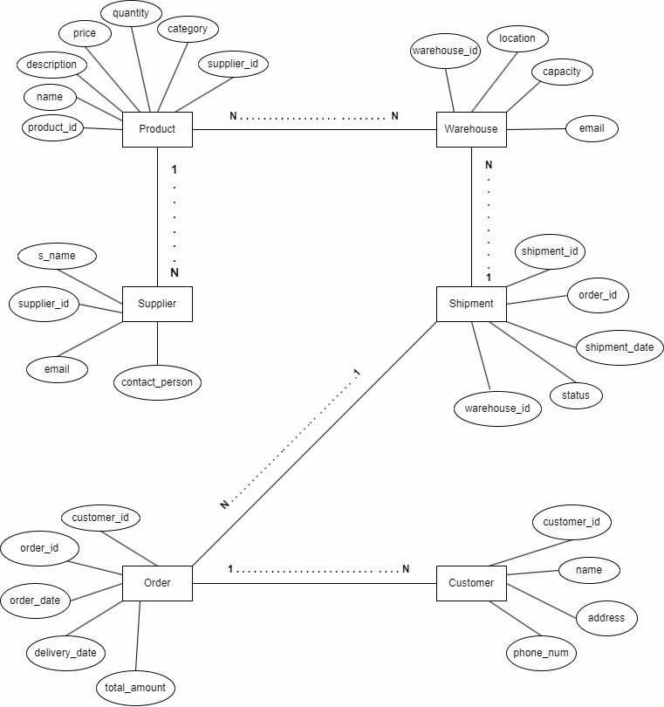
ER DIAGRAM
Entities:
Product
Supplier
Purchase_Order
Stock
Payment
Relationships:
Supplier supplies Product (Many-to-Many)
Purchase_Order resolves the M:N relationship
Stock depends on Product
Payment is linked to Purchase_Order

Slide 5
EXPlanation
A supplier can supply multiple products
A product can be supplied by multiple suppliers
Purchase_Order acts as an associative entity
Stock stores available quantity of products
Payment maintains transaction details

Slide 6
ABSTRACT ER TABLES
PURCHASE_ORDER
Order_ID (Primary Key)
Order_Date
Quantity
Supplier_ID (Foreign Key)
Product_ID (Foreign Key)
STOCK
Stock_ID (Primary Key)
Product_ID (Foreign Key)
Available_Quantity
Last_Updated
PAYMENT
Payment_ID (Primary Key)
Order_ID (Foreign Key)
Amount
Payment_Date
Payment_Mode
PRODUCT
Product_ID (Primary Key)
Product_Name
Category
Unit_Price
SUPPLIER
Supplier_ID (Primary Key)
Supplier_Name
Phone
Email

Slide 7
MODULES & CONCLUSION
Modules:
Product Management Module
Supplier Management Module
Inventory Management Module
Purchase Order Management Module
Payment Management Module
Conclusion: The Inventory & Supplier Management System provides a structured database design that ensures accurate inventory tracking, efficient supplier management, and reliable data consistency.

